Slide 1
Network Monitoring(SNMP) & Nagios3

Slide 2
Agenda
SNMP
MIB / SMI / Object Identifier Tree
Nagios3
Demo: FTP Tester

Slide 3
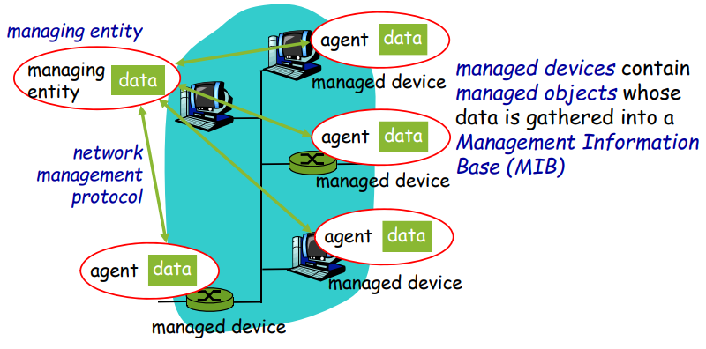
Network Management

Slide 4
Network Management
Management Information Base (Managing Entity)
Managed Devices (Agents)

Slide 5
Simple Network Management Protocol(SNMP)
Internet roots (SGMP)
Started very simple
deployed and adopted rabidly
grew quickly in size and complexity
SNMP v3
Standard for Network managing

Slide 6
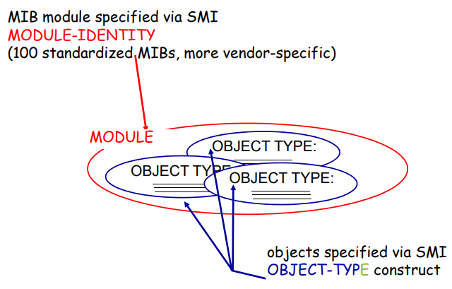
SMI (Structure of Management Information)
Data definition language for MIB objects
OBJECT-TYPE
MODULE-IDENTITY

Slide 7
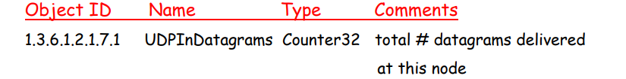
MIB Examples

Slide 8
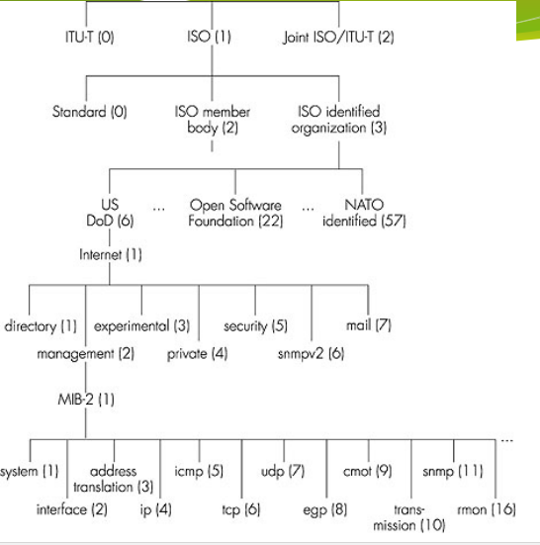
Object Identifier Tree

Slide 9
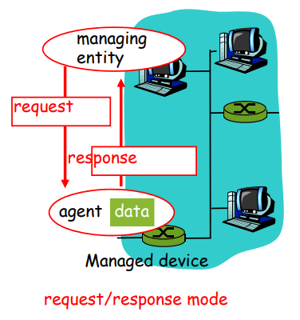
SNMP Protocol

Slide 10
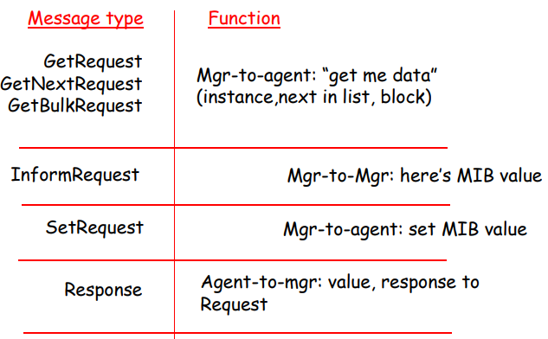
SNMP Protocol

Slide 11
SNMP: Security & Administration
Encryption
DES-Encryption
Authentication
MIC(m,k) Compute hash(MIC) over message(m) with secret shared key(k)
Playback attack protection
Nonce
View-based access control
Rights, Policies

Slide 12
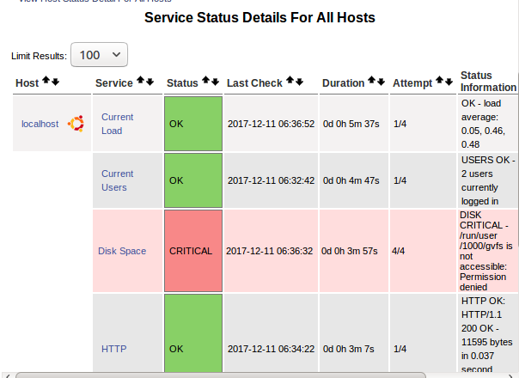
Nagios3

Slide 13
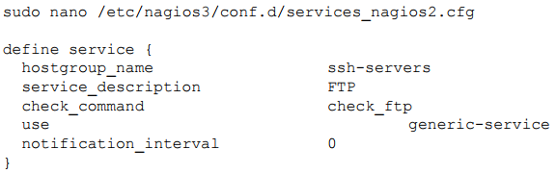
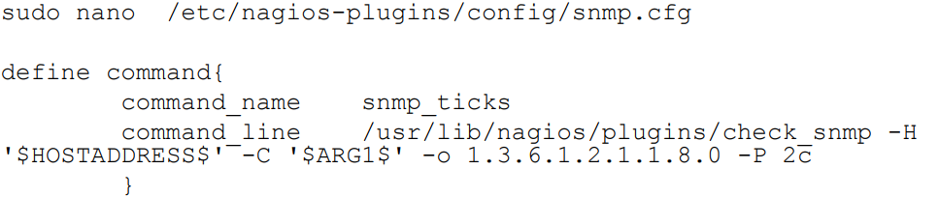
Nagios3 - Services and Commands
Adding FTP Tester plugin
Customized Command for FTP Tester plugin

